Slide 1
Health Economic Analysis
Review of Analysis & Visualizations
Notes:
Generated based on repository content. Note: User requested 'Puberty Blocker Ban' context, but repository contains 'Health Economic Analysis' for HPV, Smoking, Hep C, Obesity. Presentation reflects repository content.

Slide 2
Outline
1. Introduction
2. One-Way DSA Tornado Plots
3. Three-Way DSA 3D Plots
4. Scatter Plots
5. Heatmaps
6. Conclusion

Slide 3
One Way Dsa Tornado Childhood Obesity Prevention Hs
Notes:
Figure: One Way Dsa Tornado Childhood Obesity Prevention Hs
Source: one_way_dsa_tornado_childhood_obesity_prevention_hs.png

Slide 4
One Way Dsa Tornado Childhood Obesity Prevention Soc
Notes:
Figure: One Way Dsa Tornado Childhood Obesity Prevention Soc
Source: one_way_dsa_tornado_childhood_obesity_prevention_soc.png

Slide 5
One Way Dsa Tornado Hepatitis C Therapy Hs
Notes:
Figure: One Way Dsa Tornado Hepatitis C Therapy Hs
Source: one_way_dsa_tornado_hepatitis_c_therapy_hs.png

Slide 6
One Way Dsa Tornado Hepatitis C Therapy Soc
Notes:
Figure: One Way Dsa Tornado Hepatitis C Therapy Soc
Source: one_way_dsa_tornado_hepatitis_c_therapy_soc.png

Slide 7
One Way Dsa Tornado Housing Insulation Hs
Notes:
Figure: One Way Dsa Tornado Housing Insulation Hs
Source: one_way_dsa_tornado_housing_insulation_hs.png

Slide 8
One Way Dsa Tornado Housing Insulation Soc
Notes:
Figure: One Way Dsa Tornado Housing Insulation Soc
Source: one_way_dsa_tornado_housing_insulation_soc.png

Slide 9
One Way Dsa Tornado Hpv Vaccination Hs
Notes:
Figure: One Way Dsa Tornado Hpv Vaccination Hs
Source: one_way_dsa_tornado_hpv_vaccination_hs.png

Slide 10
One Way Dsa Tornado Hpv Vaccination Soc
Notes:
Figure: One Way Dsa Tornado Hpv Vaccination Soc
Source: one_way_dsa_tornado_hpv_vaccination_soc.png

Slide 11
One Way Dsa Tornado Smoking Cessation Hs
Notes:
Figure: One Way Dsa Tornado Smoking Cessation Hs
Source: one_way_dsa_tornado_smoking_cessation_hs.png

Slide 12
One Way Dsa Tornado Smoking Cessation Soc
Notes:
Figure: One Way Dsa Tornado Smoking Cessation Soc
Source: one_way_dsa_tornado_smoking_cessation_soc.png

Slide 13
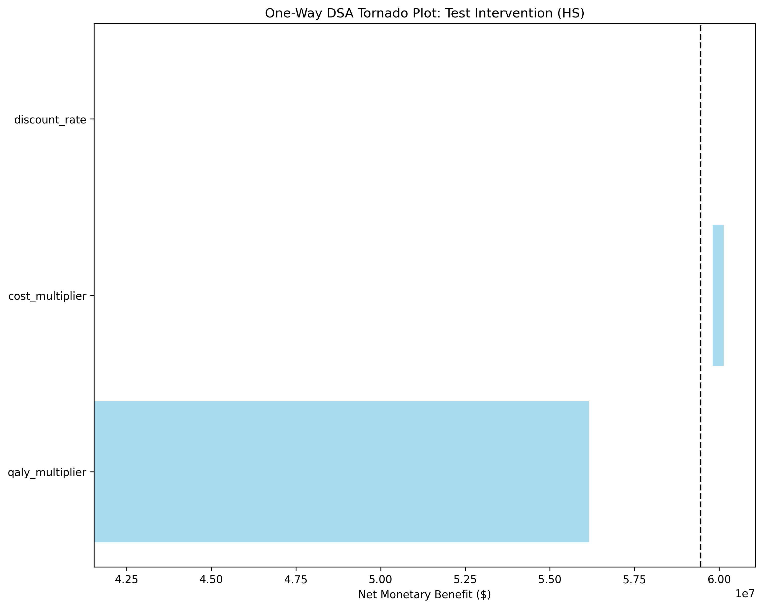
One Way Dsa Tornado Test Intervention Hs
Notes:
Figure: One Way Dsa Tornado Test Intervention Hs
Source: one_way_dsa_tornado_test_intervention_hs.png

Slide 14

One Way Dsa Tornado Test Intervention Soc
Notes:
Figure: One Way Dsa Tornado Test Intervention Soc
Source: one_way_dsa_tornado_test_intervention_soc.png

Slide 15
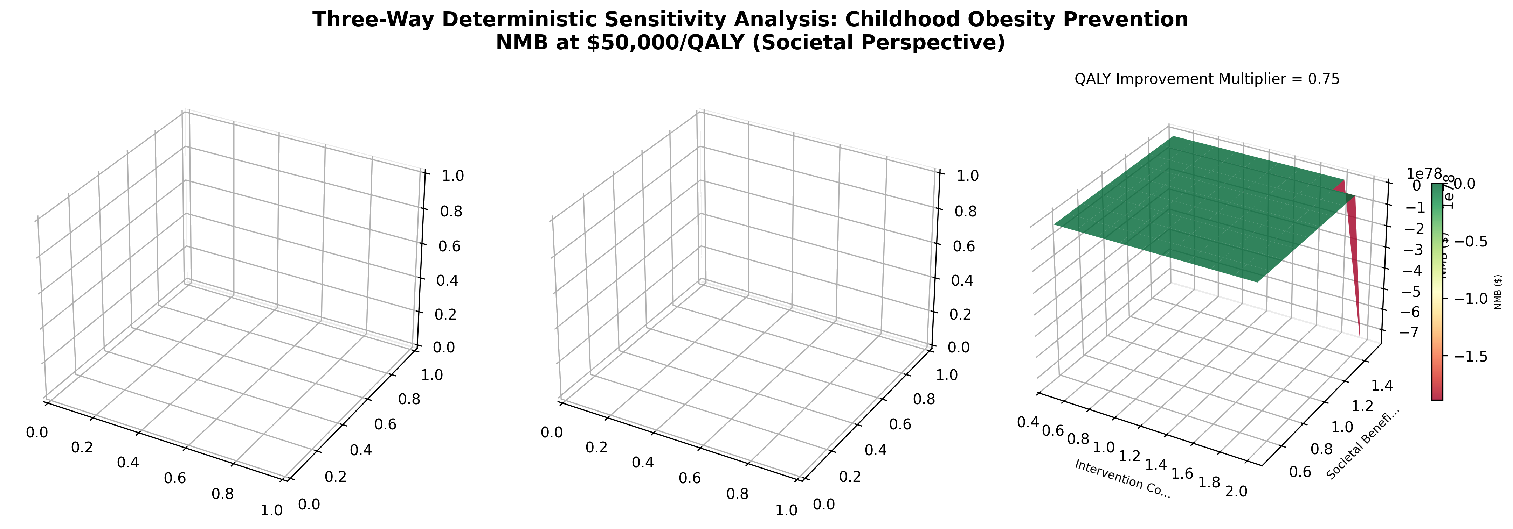
Three Way Dsa 3D Childhood Obesity Prevention
Notes:
Figure: Three Way Dsa 3D Childhood Obesity Prevention
Source: three_way_dsa_3d_childhood_obesity_prevention.png

Slide 16
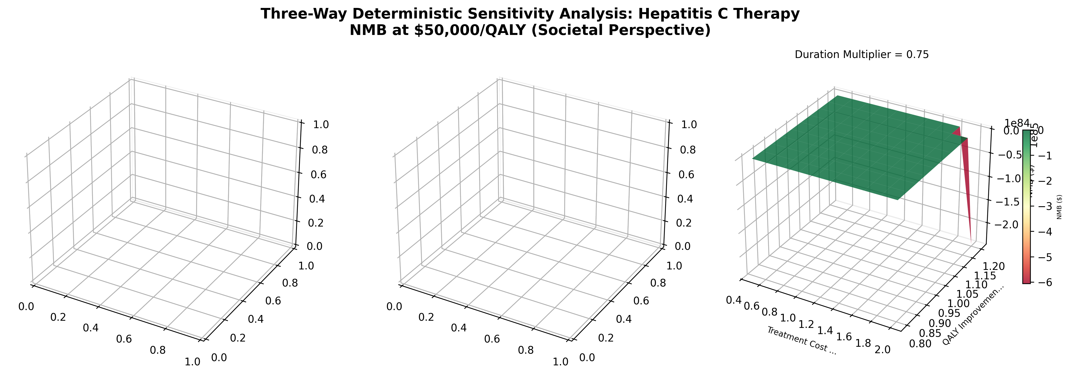
Three Way Dsa 3D Hepatitis C Therapy
Notes:
Figure: Three Way Dsa 3D Hepatitis C Therapy
Source: three_way_dsa_3d_hepatitis_c_therapy.png

Slide 17
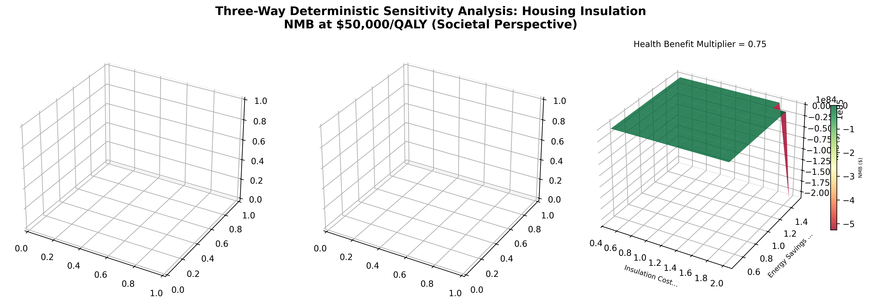
Three Way Dsa 3D Housing Insulation
Notes:
Figure: Three Way Dsa 3D Housing Insulation
Source: three_way_dsa_3d_housing_insulation.png

Slide 18
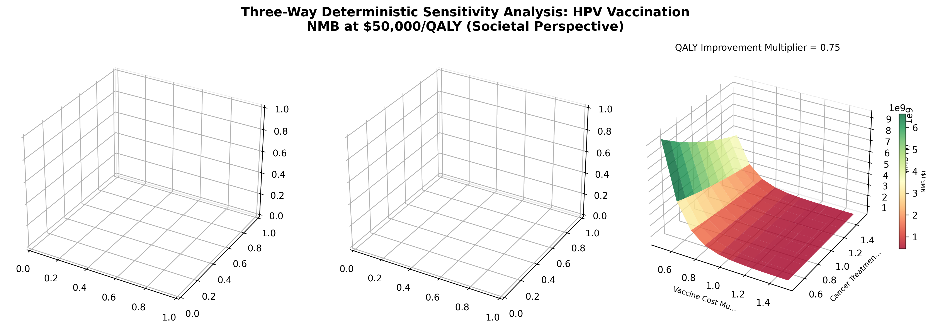
Three Way Dsa 3D Hpv Vaccination
Notes:
Figure: Three Way Dsa 3D Hpv Vaccination
Source: three_way_dsa_3d_hpv_vaccination.png

Slide 19
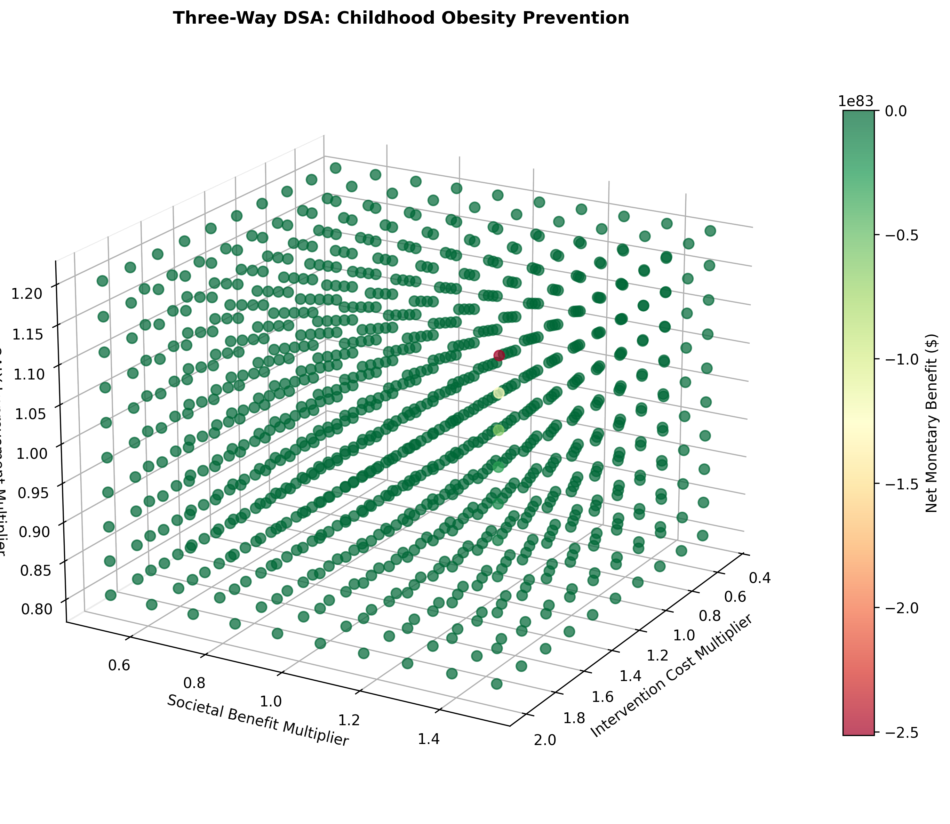
Three Way Dsa 3D Scatter Childhood Obesity Prevention
Notes:
Figure: Three Way Dsa 3D Scatter Childhood Obesity Prevention
Source: three_way_dsa_3d_scatter_childhood_obesity_prevention.png

Slide 20
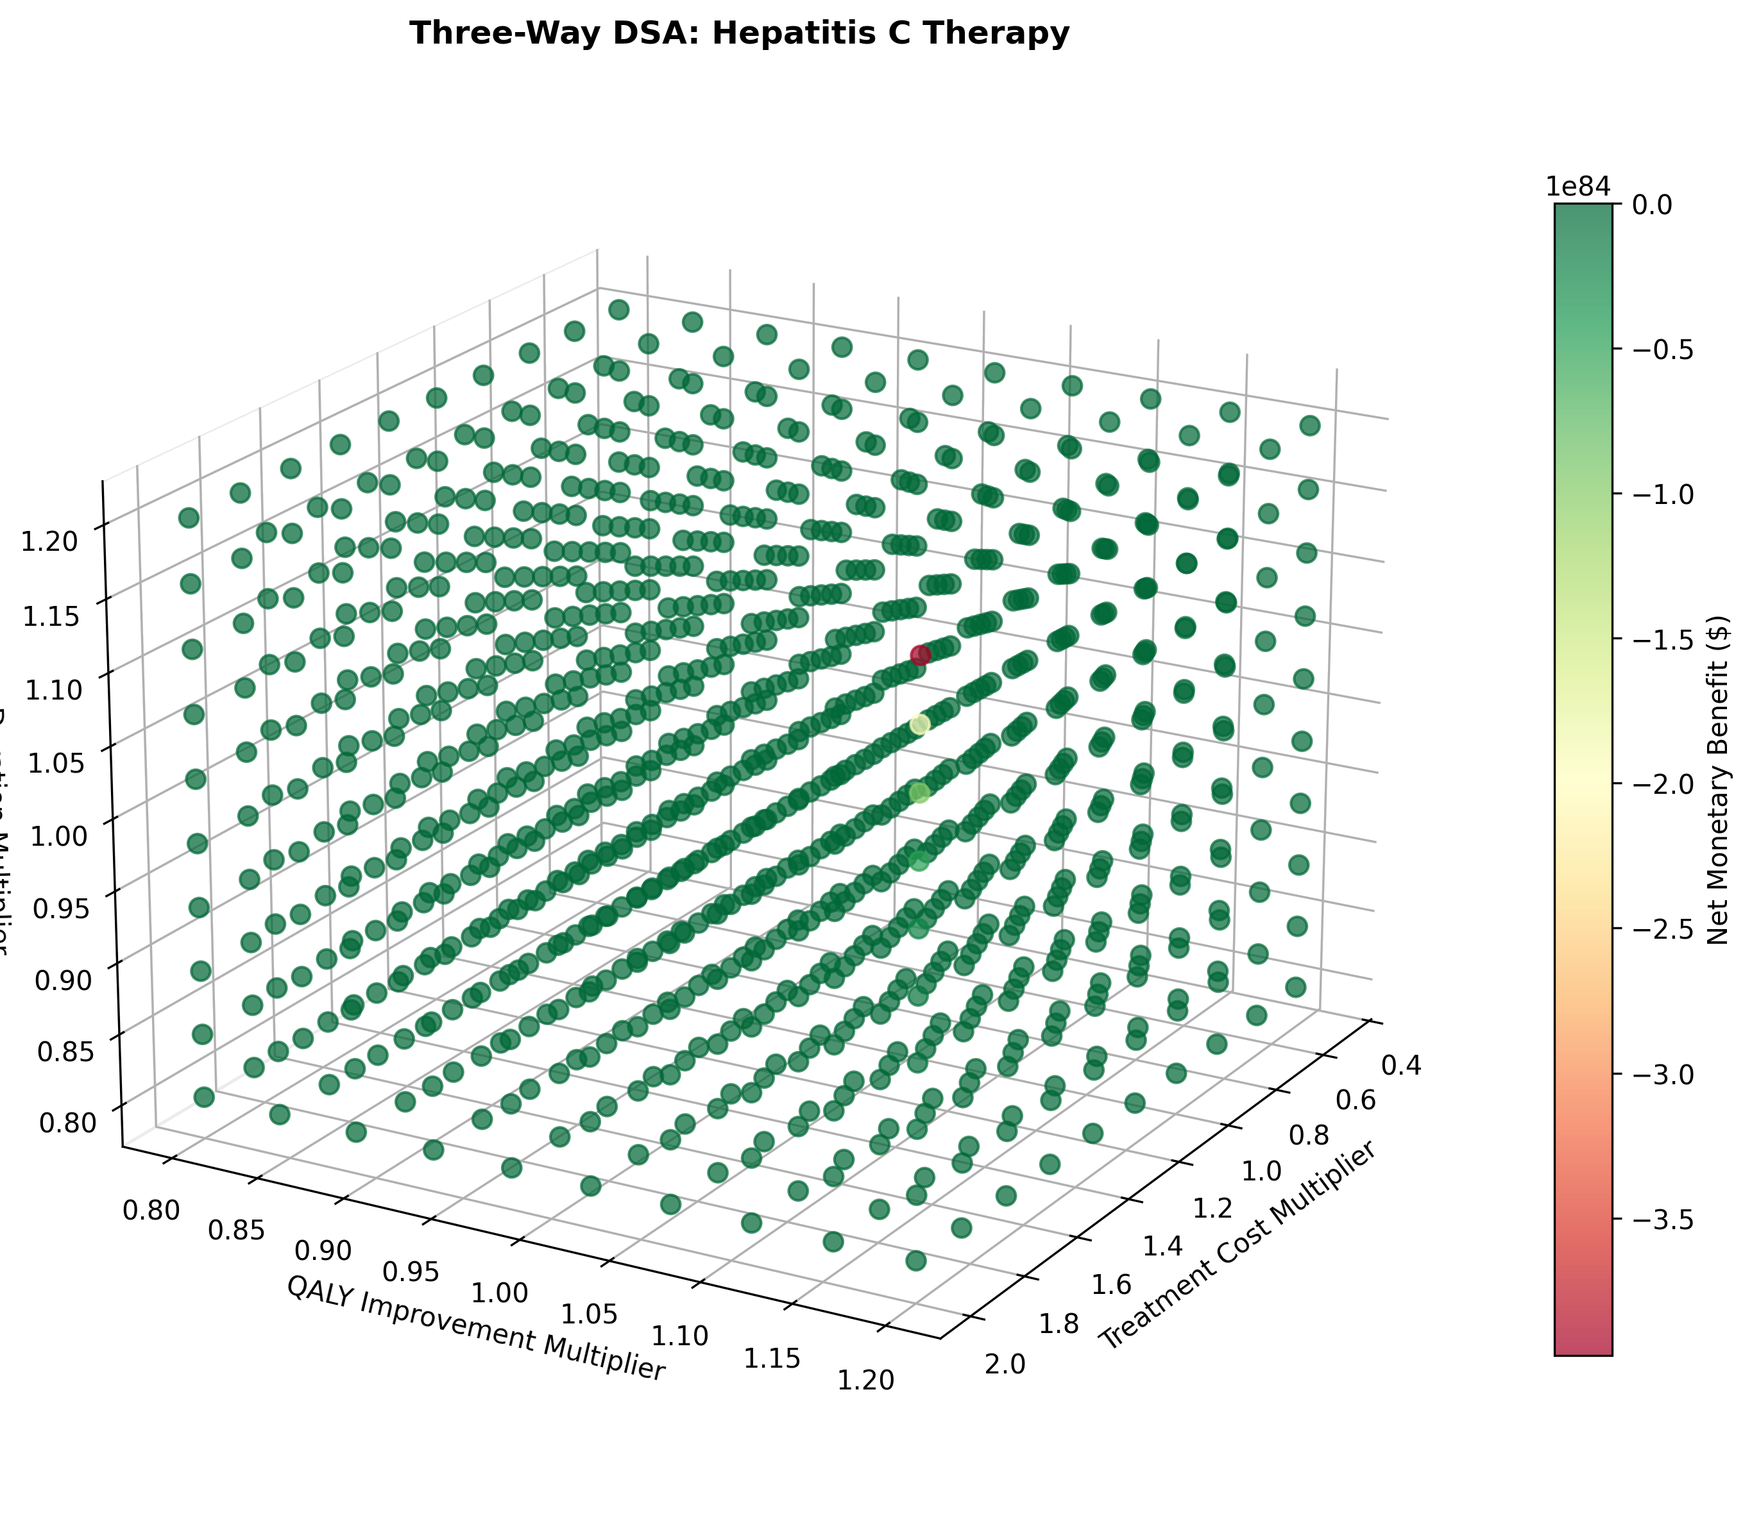
Three Way Dsa 3D Scatter Hepatitis C Therapy
Notes:
Figure: Three Way Dsa 3D Scatter Hepatitis C Therapy
Source: three_way_dsa_3d_scatter_hepatitis_c_therapy.png

Slide 21
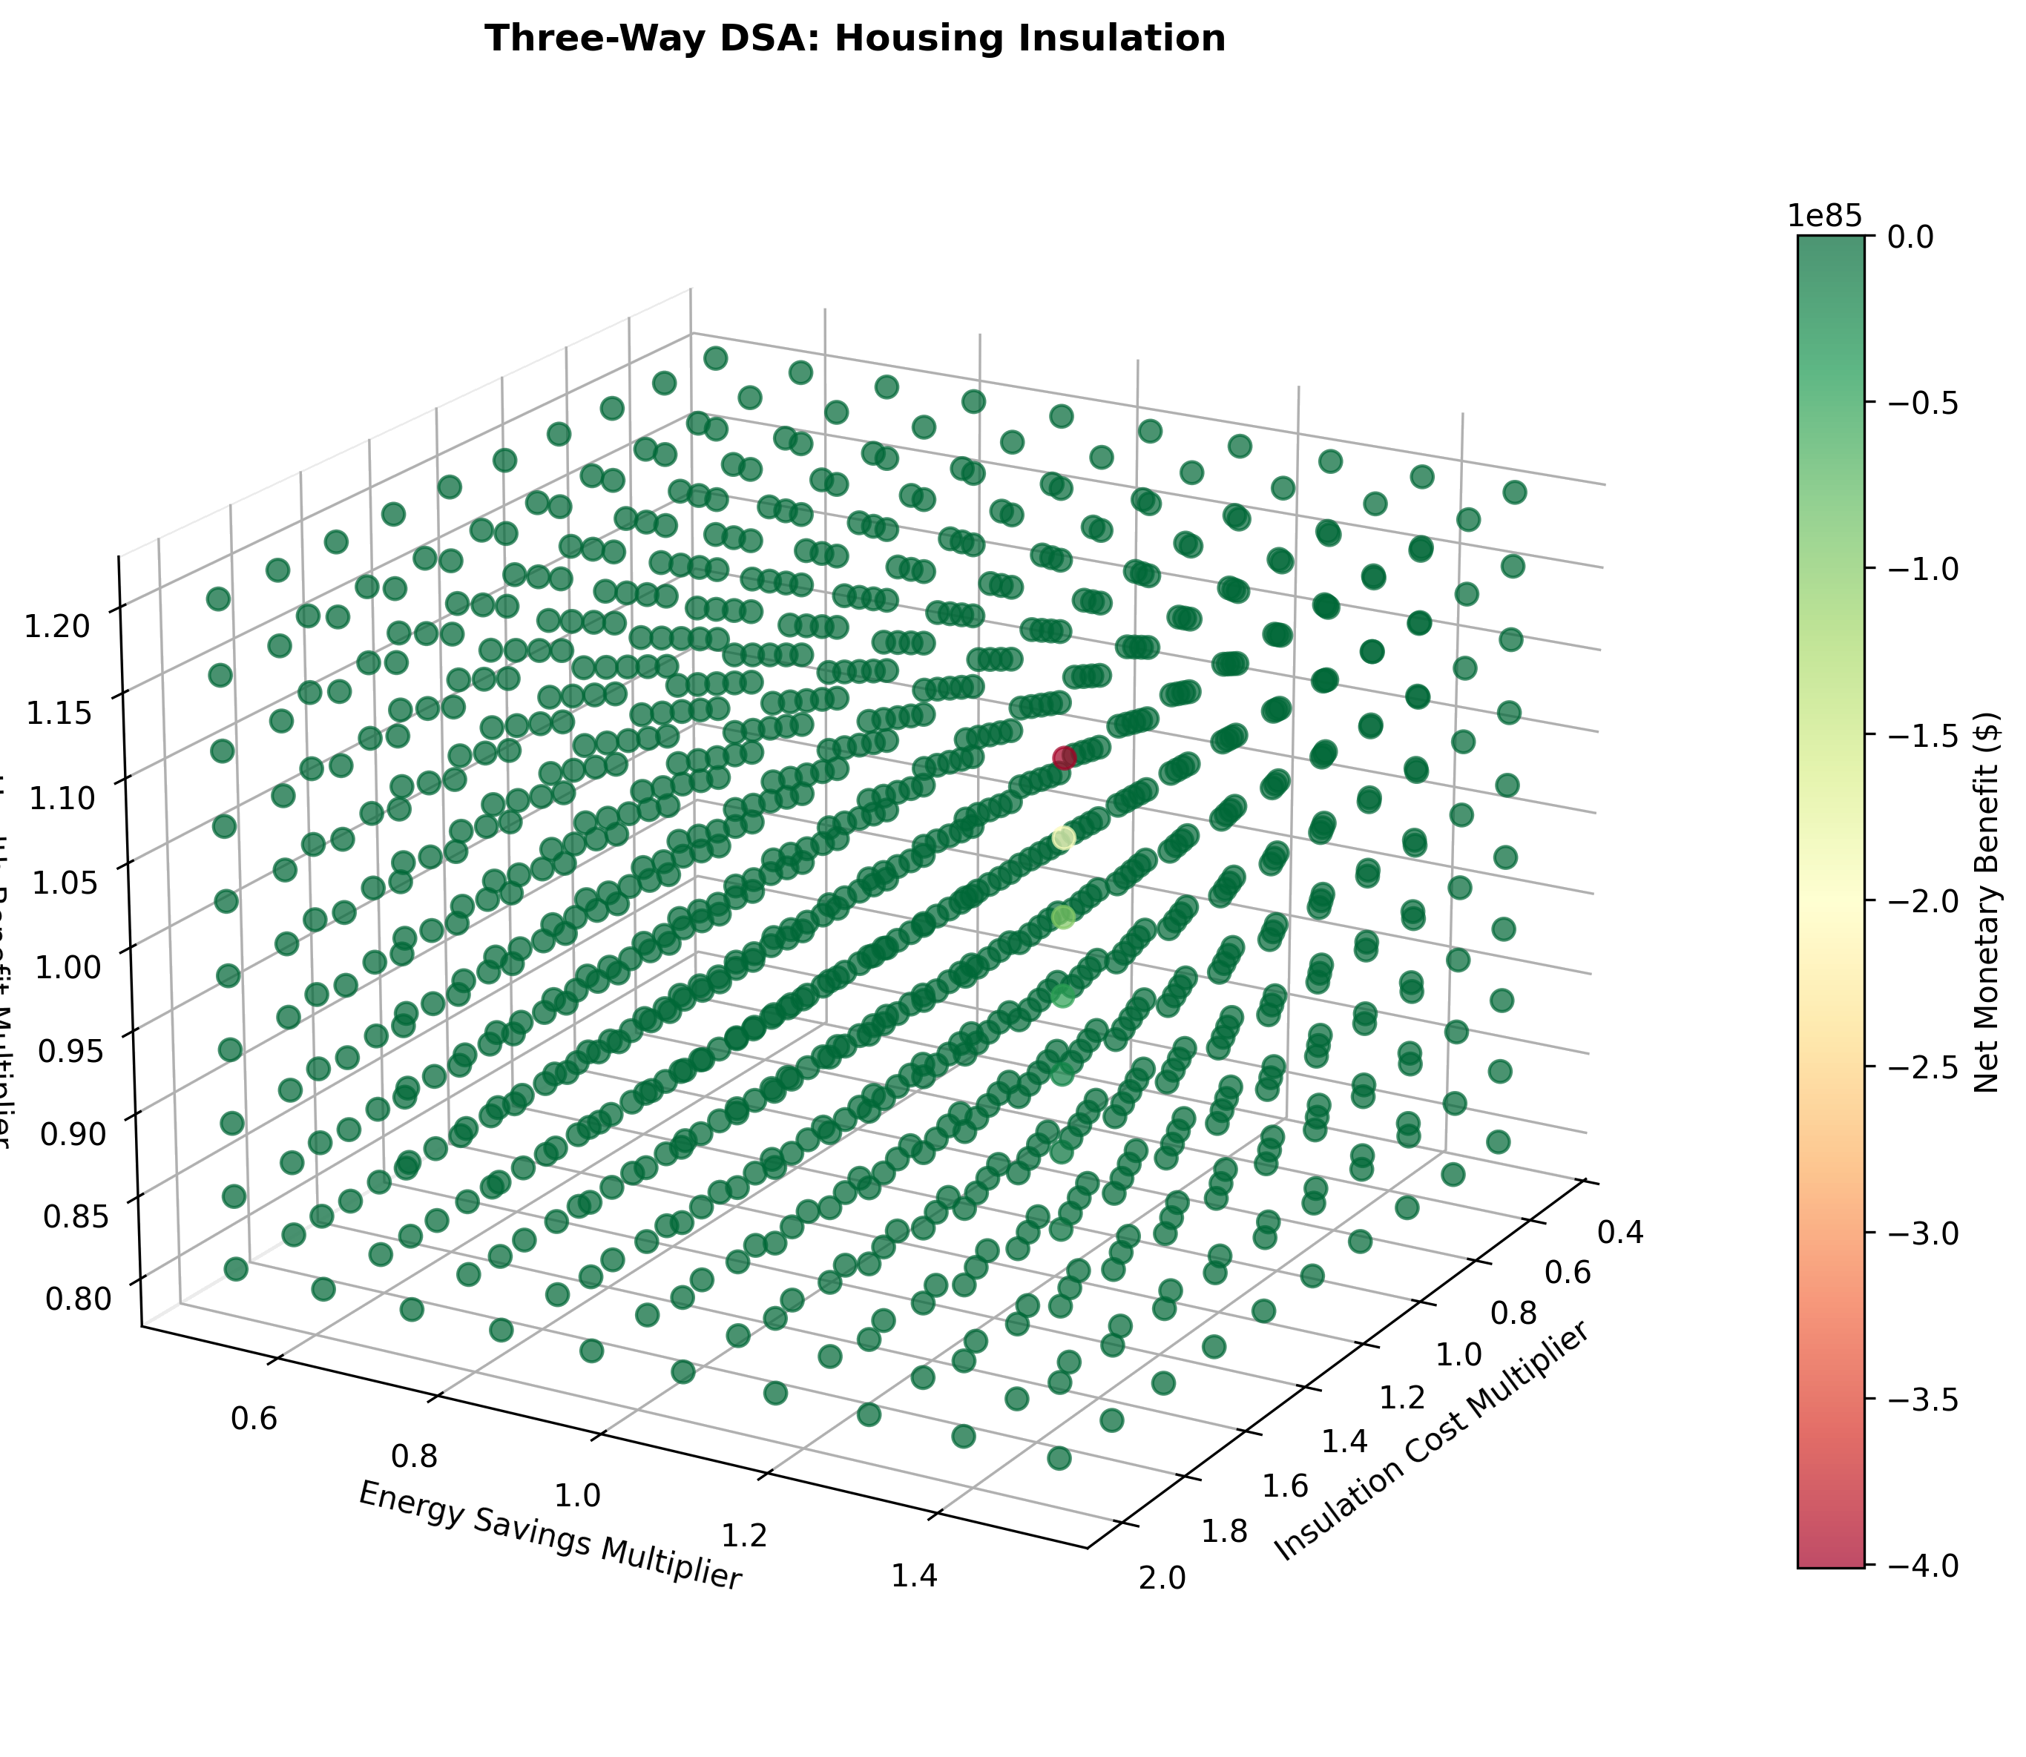
Three Way Dsa 3D Scatter Housing Insulation
Notes:
Figure: Three Way Dsa 3D Scatter Housing Insulation
Source: three_way_dsa_3d_scatter_housing_insulation.png

Slide 22
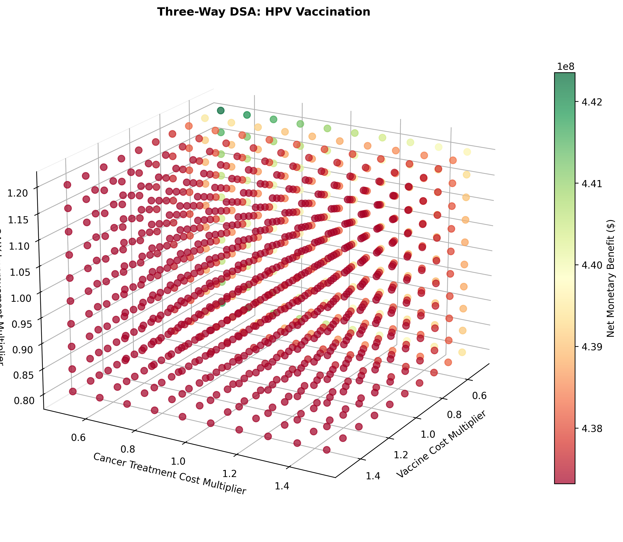
Three Way Dsa 3D Scatter Hpv Vaccination
Notes:
Figure: Three Way Dsa 3D Scatter Hpv Vaccination
Source: three_way_dsa_3d_scatter_hpv_vaccination.png

Slide 23

Three Way Dsa 3D Scatter Smoking Cessation
Notes:
Figure: Three Way Dsa 3D Scatter Smoking Cessation
Source: three_way_dsa_3d_scatter_smoking_cessation.png

Slide 24
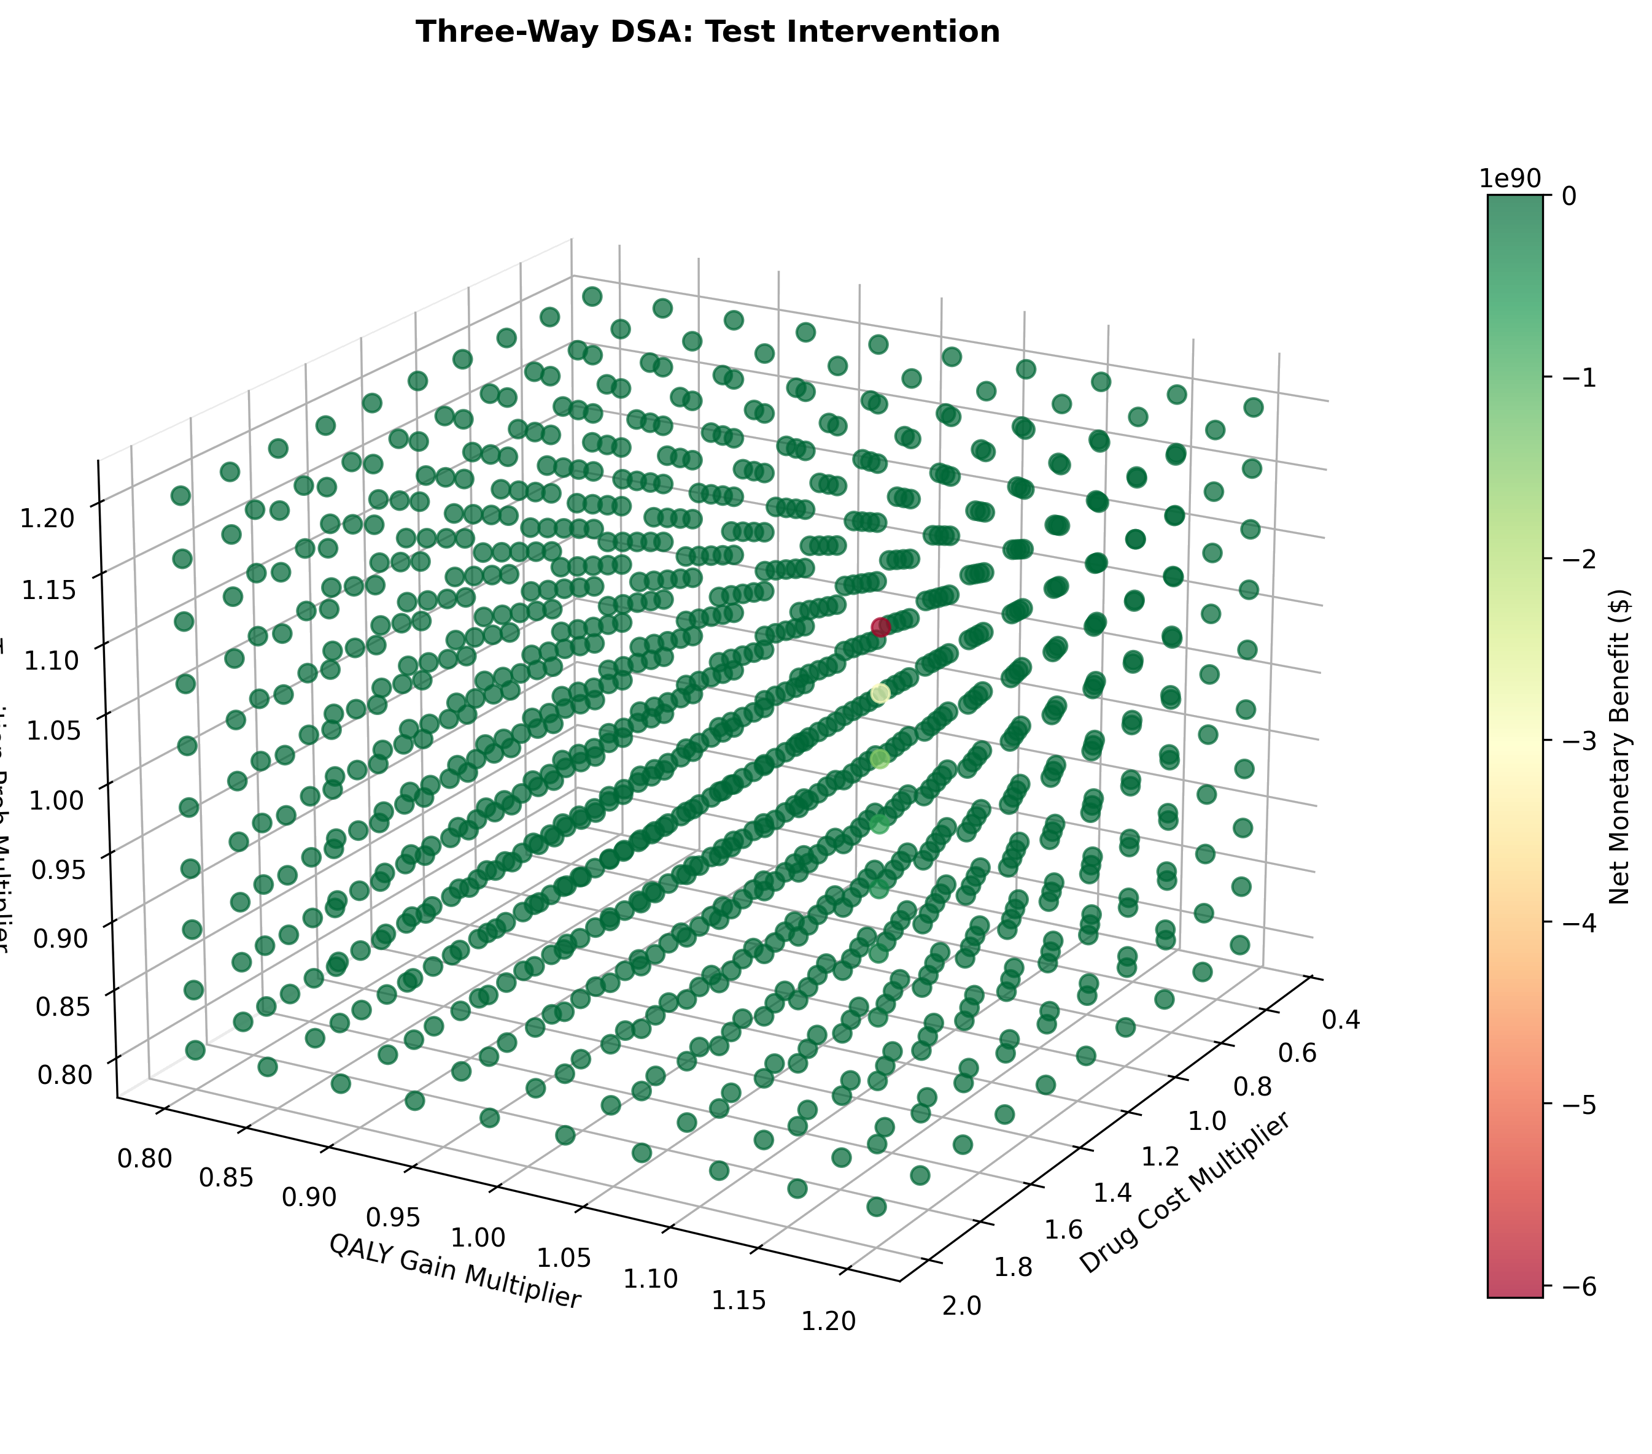
Three Way Dsa 3D Scatter Test Intervention
Notes:
Figure: Three Way Dsa 3D Scatter Test Intervention
Source: three_way_dsa_3d_scatter_test_intervention.png

Slide 25

Three Way Dsa 3D Smoking Cessation
Notes:
Figure: Three Way Dsa 3D Smoking Cessation
Source: three_way_dsa_3d_smoking_cessation.png

Slide 26
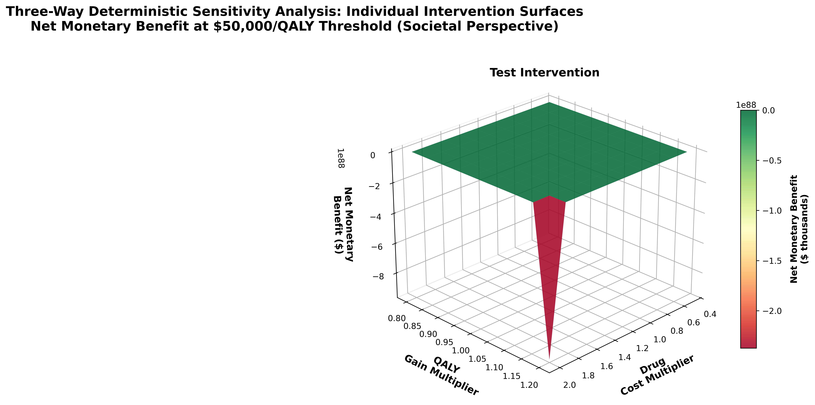
Three Way Dsa 3D Subplots Publication
Notes:
Figure: Three Way Dsa 3D Subplots Publication
Source: three_way_dsa_3d_subplots_publication.png

Slide 27
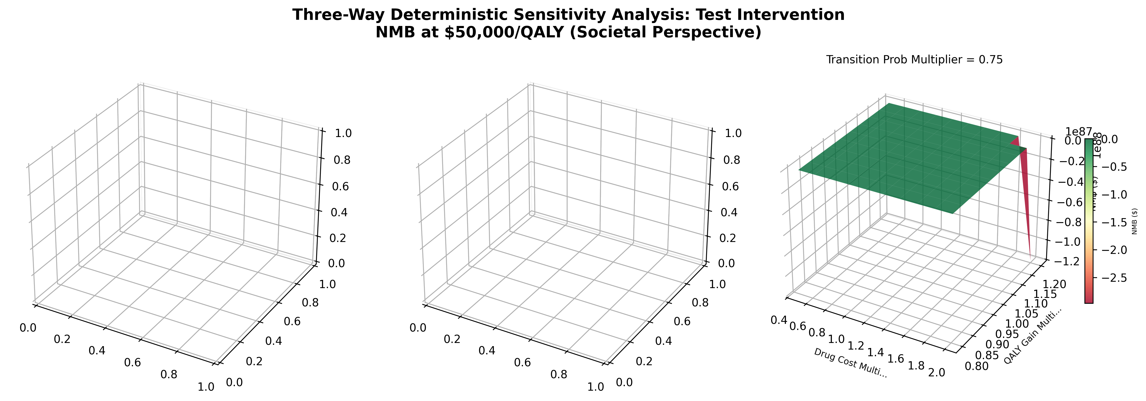
Three Way Dsa 3D Test Intervention
Notes:
Figure: Three Way Dsa 3D Test Intervention
Source: three_way_dsa_3d_test_intervention.png

Slide 28
Two Way Dsa Heatmaps Hs
Notes:
Figure: Two Way Dsa Heatmaps Hs
Source: two_way_dsa_heatmaps_hs.png

Slide 29
Two Way Dsa Heatmaps Soc
Notes:
Figure: Two Way Dsa Heatmaps Soc
Source: two_way_dsa_heatmaps_soc.png

Slide 30
Thank You
Questions?

